Slide 1
INTRODUCTION TO PSYCHOLOGY
Sumitava Mukherjee
sm1@hss.iitd.ac.in
Read: https://nobaproject.com/modules/thinking-like-a-psychological-scientist

Slide 2
How to find the reason for car accidents?
Explore all possible causes
Understanding possible when all explanations have been explored and falsified
  Ex: Does sandals versus shoes contribute to increased chance of accidents?
  Ex: Does using mobile phones contribute to increased chance of accidents?
  Why?
  What does that say about how our mind works?

Slide 3
Objectivity vs subjectivity
Is psychology a science?
Is psychology subjective?
Is psychological science a “science”?
Is earth science a “science”?
The reliance of inter-subjectivity in psychology and social science

Slide 4
Is/can science be truly objective?
All of science is informed by values, Nothing is completely objective (Thomas Kuhn)
Scientists are humans and hence influenced by values, personal/cultural variables, experiences, opinions, beliefs, etc.
There is a difference between FACTS (information about the world) and VALUES (Beliefs about the way the world is or should be).

Slide 5
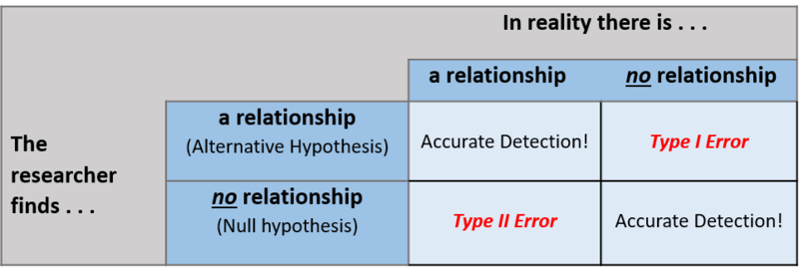
Issues with measurement
(C) Erin I. Smith. http://noba.to/nt3ysqcm CC-BY-NC-SA 4.0 License.

Slide 6
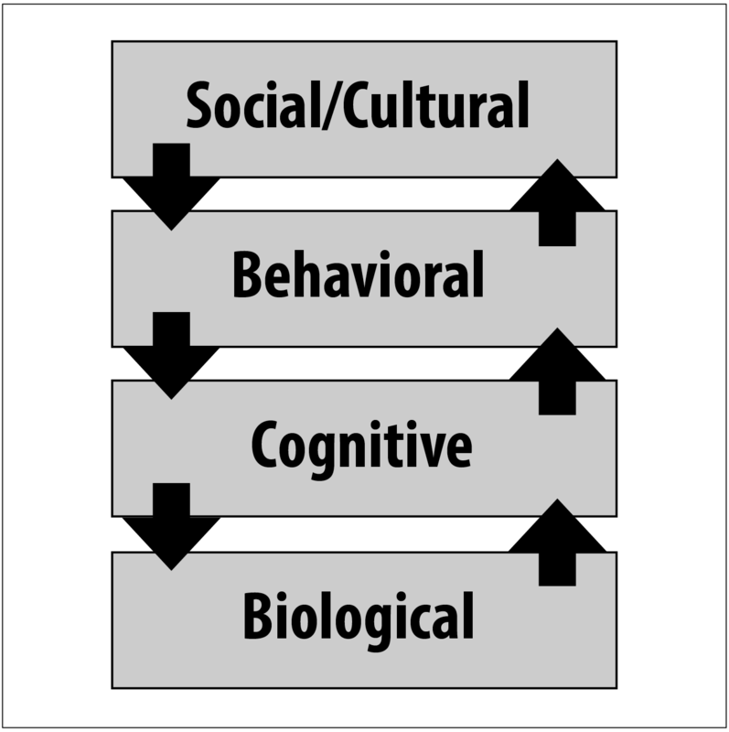
Studying a psychological phenomena
Levels of analysis
Example: Cramming for test
How presence of others or teachers matter, family structure, cultural norms of learning, schooling systems
How long is the study period, What is the time table, Social stress
What information is attended to, memory traces and models, ability to focus, decision strategies
Brain areas/processes (via fMRI), Genetic markup, Neuronal connections, Different biochemical pathways in the brain

Slide 7
Studying real world phenomena:
REAL OBSERVATION TO THEORY TO APPLIED
Studying abstract phenomena:
SIMPLE DE-CONTEXTUAL STIMULI IN THE LAB TO THEORY AND FOUNDATIONS

Slide 8
Types of scientific research in psychology
Lay Intuitions ~ still capture it as folk understanding
Preferences, Opinions
Experimentation
Qualitative studies
Computational studies, simulations

Slide 9
Intuitions about the psychology of gains and losses
Click here: https://bit.ly/3A3gpvJ

Slide 10

Studying real world phenomena:
OBSERVATION to Experimental work to THEORY
Does price increase or price decrease have more effect on our emotions?
Mukherjee, S. et al. (2017).
Is loss-aversion magnitude-dependent? Measuring prospective affective judgments regarding gains and losses. Judgment and Decision making, 12(1), 81.
Define Constructs: Example: Reference Price (= 45 Rs/Kg)
Operationalize variables: Gain , Loss.
Decide independent variable
Measure: Relative intensity of a gain (price decrease to 40 Rs/kg) versus a loss (price increase to 50 Rs/Kg)
Measure from hundreds of people going to the market
Find statistical differences on the Dependent Variable
(Percent of people answering what would have more effect – gain or loss?

Slide 11
Experimental Designs

Slide 12
Types
Between – subject
Within-subject
Experiments are used to study causal relationships.
You manipulate one or more independent variables
and measure their effect on one or more dependent variables.

Slide 13
Terms
Independent Variable
Dependent Variable
Co-variates
Types: Continuous, Categorical

Slide 14
Testing
In a controlled experiment, you must be able to:
Systematically and precisely manipulate the independent variable(s).
Precisely measure the dependent variable(s).
Control any potential confounding variables.
Test for validity
  Internal validity
  External validity

Slide 15
Experimental Testing
Null hypothesis ~ No effect of independent variables on dependent variables
Have a hypothesis? = Alternate Hypothesis
Linked to theory? Or Intuition? Or previous findings?

Slide 16
Studying real world phenomena:
LAY IDEA TO BASIC RESEARCH
Think or Sleep on it
Lay intuition
Scientific Psychology
  Operationalize
  Hypothesize
  Measure
  Analyze
  Conclude

Slide 17

A common picture – is this correct?
Let the unconscious guide one’s decisions

